Slide 1
CSE2142
Writing Professional Code

Slide 2
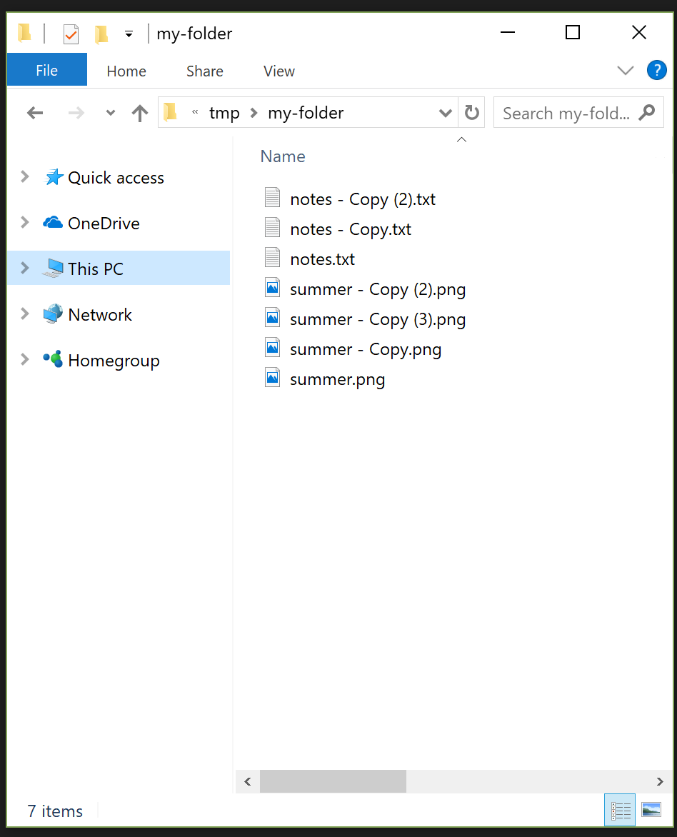

Slide 3
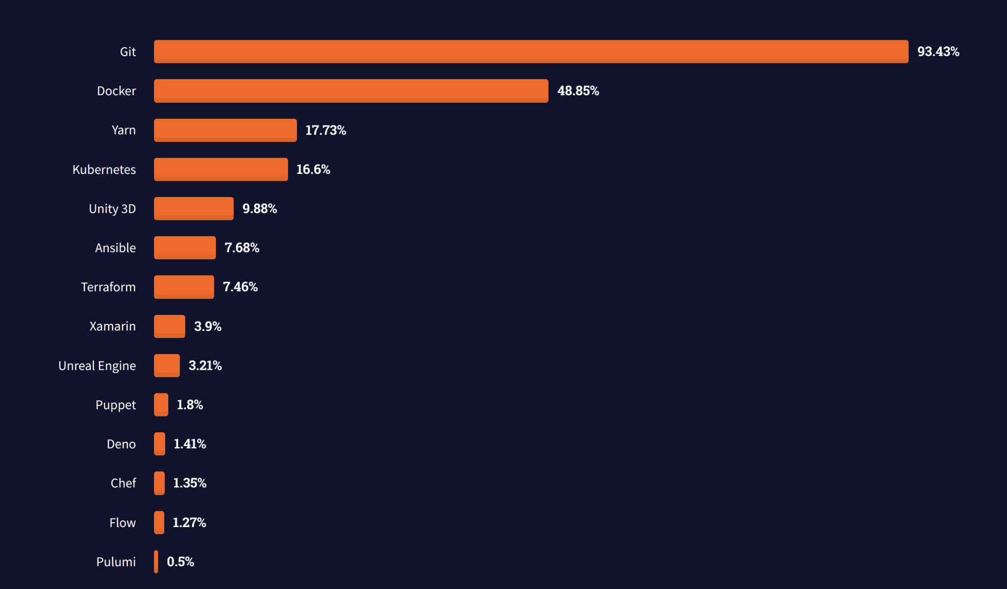

Slide 4
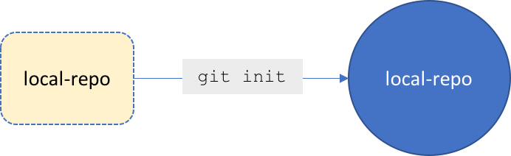
Working with Git Locally
mkdir local-repo
git status
git init
git status

Slide 5
Working with Git Locally
Create a new hello.txt
git status
untracked: Git is not tracking this file yet, usually indicating that the file is new.
tracked: The file is part of the Git snapshot and Git is tracking changes to it.
unstaged: A tracked file has changes but it has not been staged for commit.
staged: The file is ready to be committed.
deleted: The file has been deleted and should be removed from Git.

Slide 6
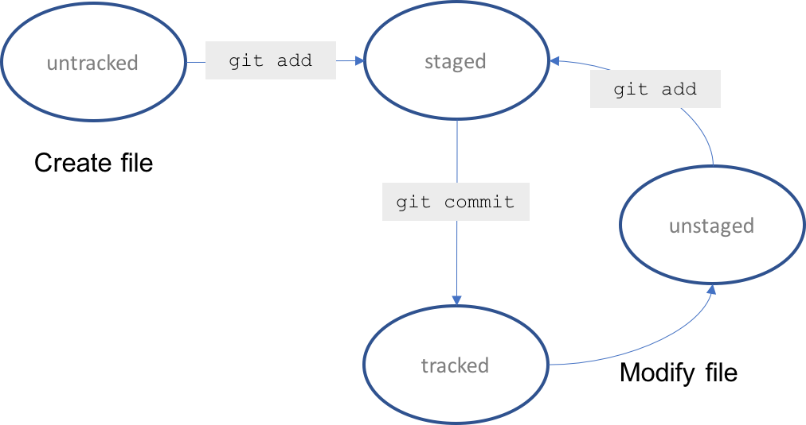

Slide 7
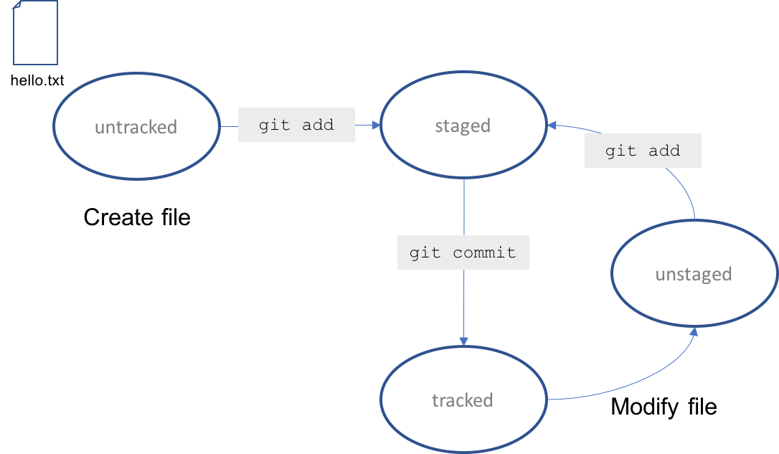

Slide 8
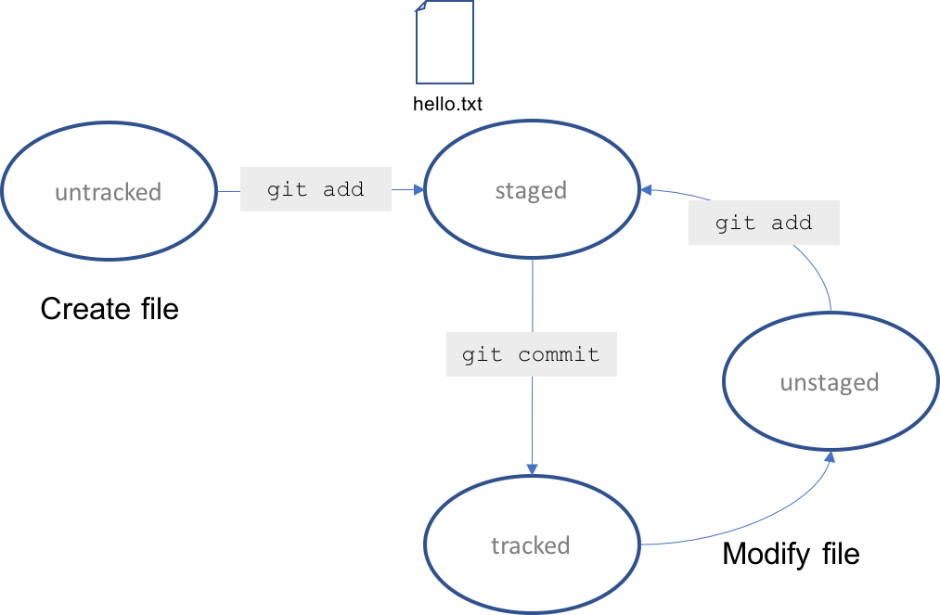
git add hello.txt

Slide 9
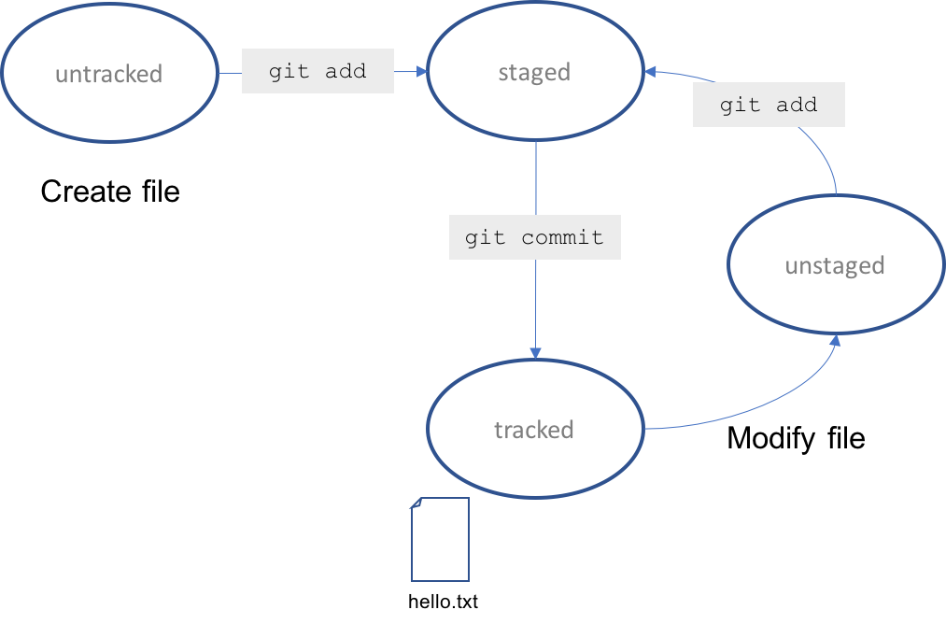
git commit -m "add a new file that will eventually contain my name"

Slide 10
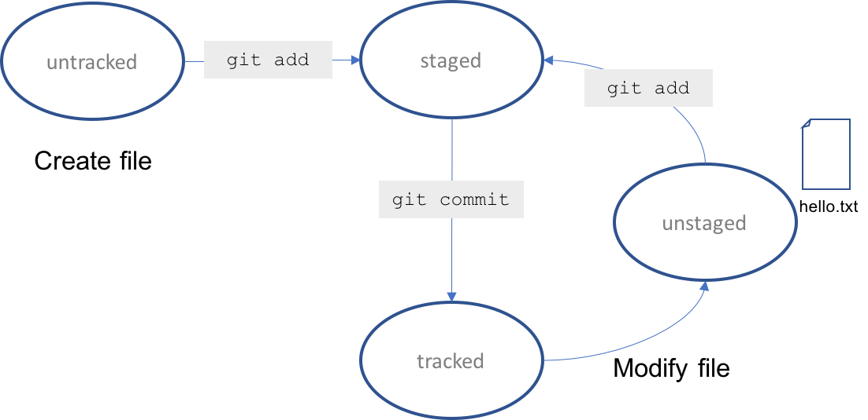

Slide 12
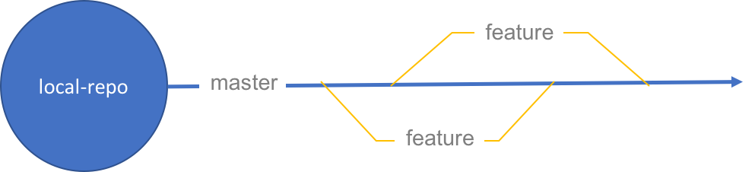
Working with Git Branches Locally
tree -> repo
main trunk -> master branch
stem -> (feature) branch

Slide 13
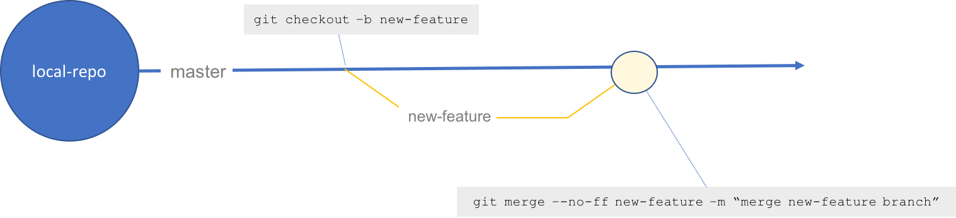
Working with Git Branches Locally
git branch
git checkout -b new-feature
Create a new text file and call it new-feature-file.txt.
List all files in the directory
git add new-feature-file.txt
git status
git commit -m "add new file"
git checkout master
List all files in the directory
git branch --no-merged
git merge --no-ff new-feature -m "merge new-feature branch"
git branch -D new-feature

Slide 14
GitHub
Create a public repo in your GitHub account and name the repo my-first-repo.
Add a text file called demo.txt
Enter the text CSE2142 into demo.txt file
Commit the file to your repo

Slide 15
Working with Git and a Remote Repository
git status - checks the state of a repo
git add - stages updates
git commit - commits updates
git checkout - switches branch
git branch - lists existing branches
git log - shows commit history

Slide 16
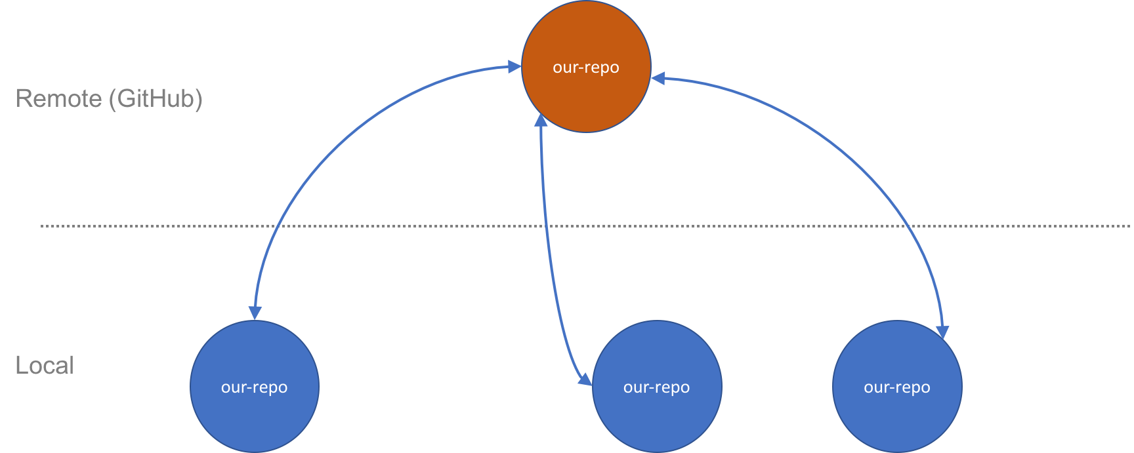

Slide 17
Create a new repo in GitHub
Name = hello-remote
Description = CSE2142 Writing Professional Code
Public or Private: Public
Initialize this repository with a README: check
Clone or download
git clone [URL]
URL format https://github.com/<username>/hello-remote.git.
Navigate into the hello-remote directory
git status

Slide 18
Working with Git and a Remote Repository
In your local clone, add a file demo.txt
git add demo.txt
git commit -m "add a text file"
git status
git push -u origin master
Browse the repo on GitHub. (change demo.txt)
git fetch origin
git pull

